Slide 1
« Efficiency is an under-product of lucidity » Albert Jacquard
Raymond Morel
Swiss Representative at IFIP GA

Slide 4
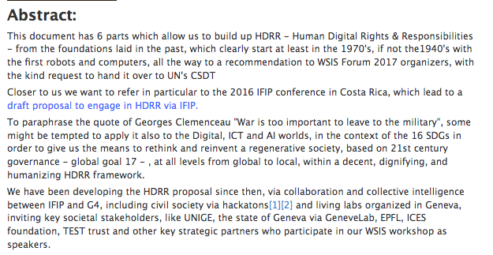

Slide 5
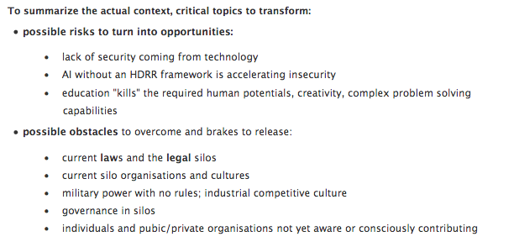

Slide 7
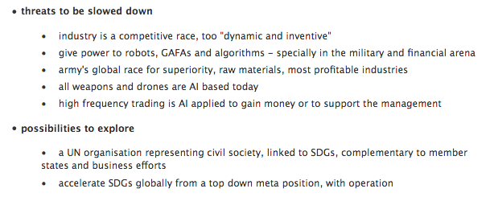

Slide 8
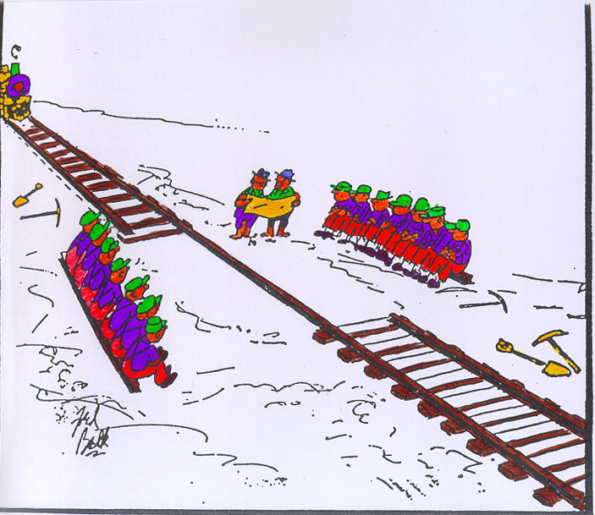

Slide 9
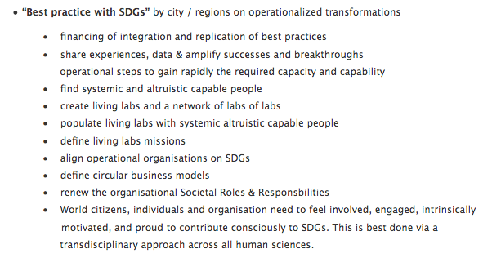

Slide 10
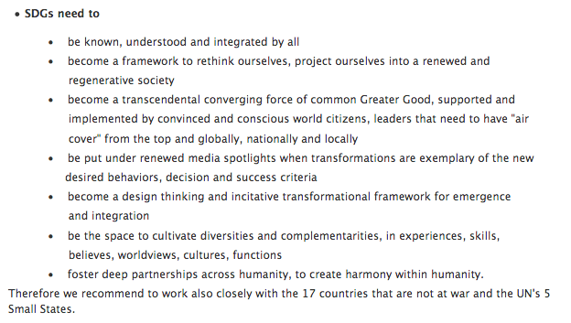

Slide 12
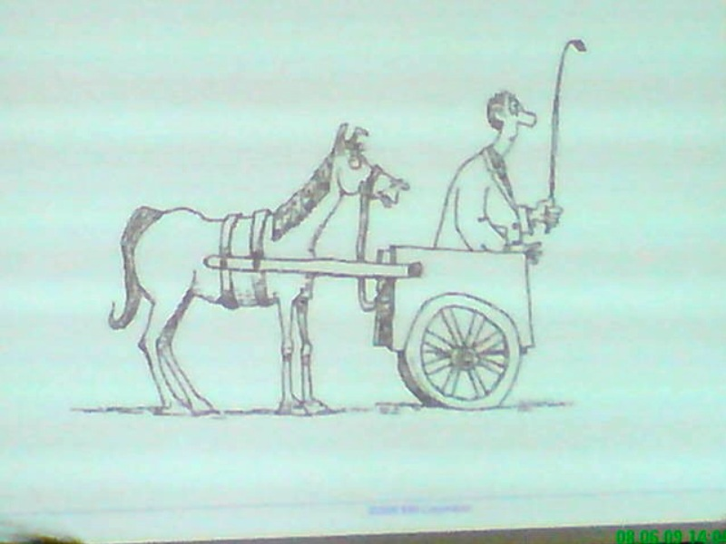

Slide 13
My first workshop in WSIS 2003 Phase I : EDUCATION and KNOWLEDGE SOCIETIES
http://iite.unesco.org/pics/publications/en/files/3214630.pdf
Education and Knowledge Societies

Slide 15
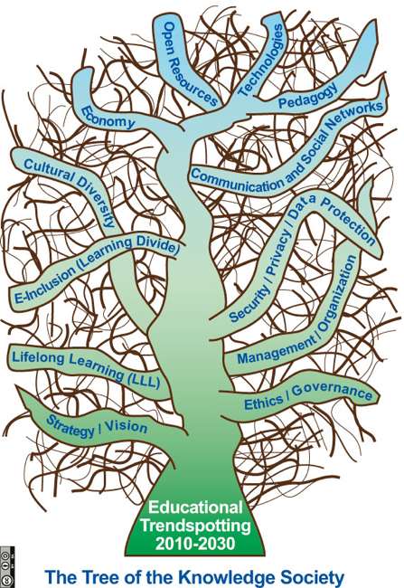

Slide 16
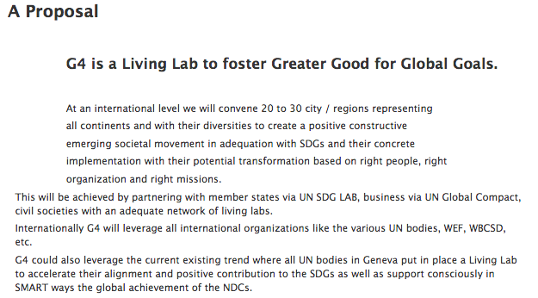

Slide 18
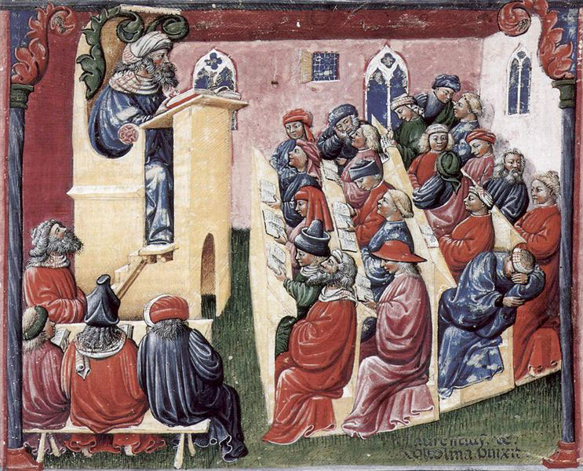

Slide 19
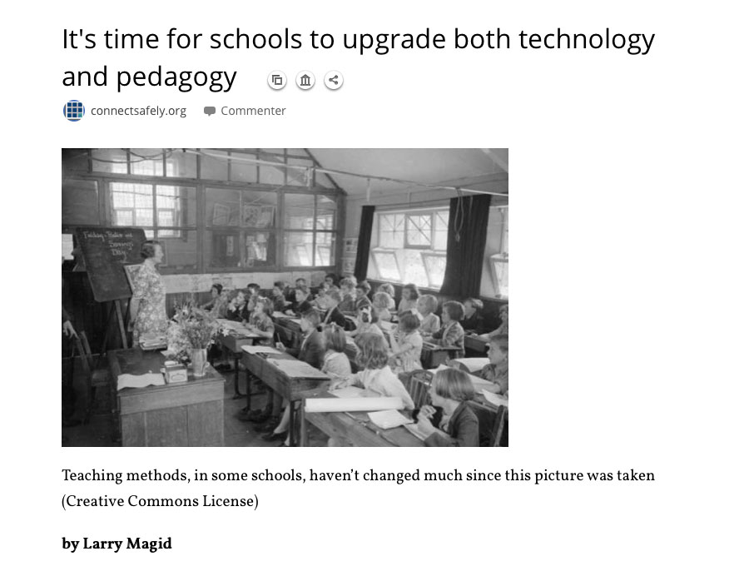

Slide 20
WRONG HYPOTHESIS
1. Finite planet ➔ growth ???!!!
2. Teacher education with 2 generations delay
3. digital pedagogy and the other pedagogy

Slide 22
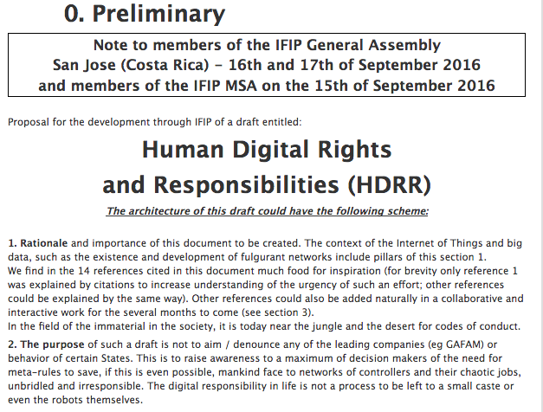

Slide 23
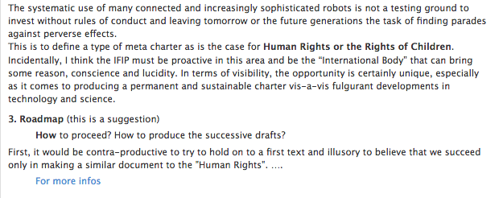

Slide 24
The complete document
http://www.ict-21.ch/com-ict/IMG/docx/Version-2.docx

Slide 27
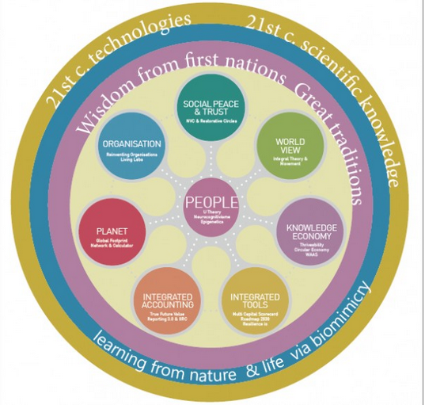

Slide 30
Enseignant communiquant
WSIS-Forum-2017-Unesco-C7-OER-15062017-Morel

Slide 31
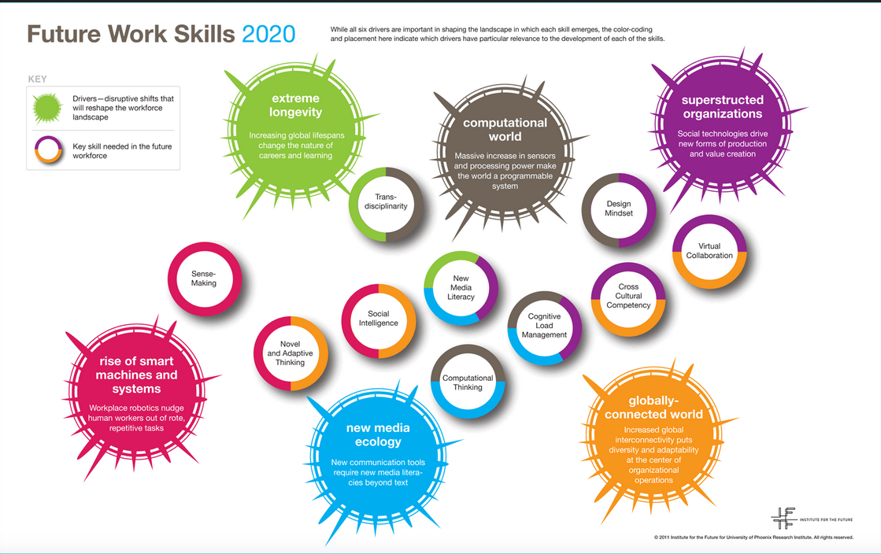
Future competencies at the digital age - reshuffle the cards –
Les compétences du futur - une manière de rebattre les cartes

Slide 36
IFIP : www.ifip.org
Social-IN3 : http://www.social-in3.coop/en/
G4 : www.g4-ll.net

